Slide 1
ADVENTURE, CAREER, COMMUNITY

Slide 2
in numbers
1987
Erasmus
started as a student exchange programme
2014
Since the beginning of the programme more than
study abroad, sports, higher education, community, cooperation
4 million
Erasmus+ students have studied abroad
Most popular countries:
Germany
Spain
Italy
The
Republic of
Serbia
becomes the
34th
Erasmus+
Programme
Country
So far more than
2019
4893
outbound students
7000
Serbian
Erasmus students
2018

Slide 3
új
ismeretek
szerzése
Professional development
Develops cultural awareness
Helps you to gain new skills
Gain knowledge in new cultures
Improves
your
language skills
Enhances your self-confidence
Strengthens social inclusion
Helps you get a good job
Brings people together

Slide 4
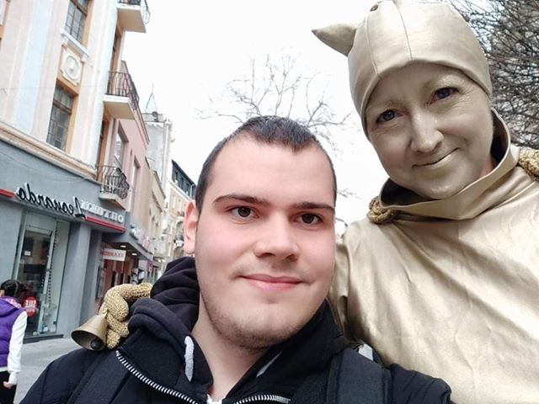
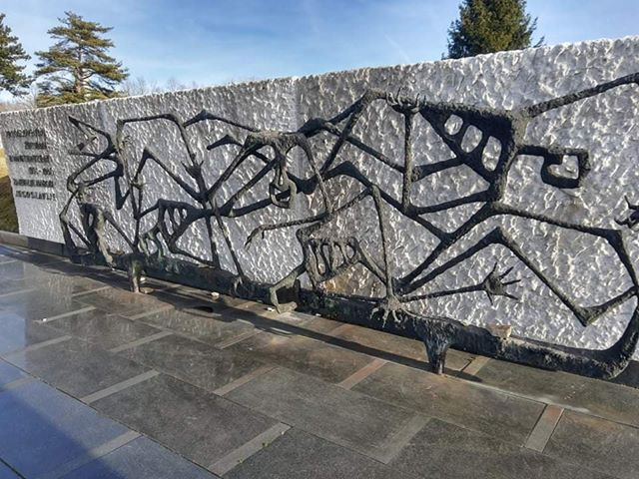
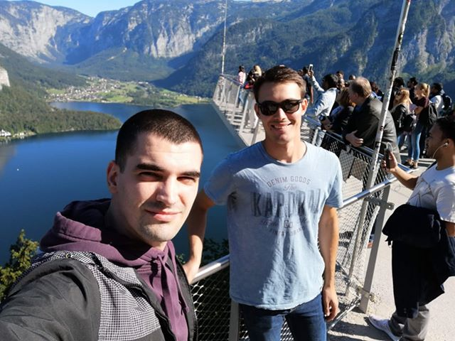
IS A GREAT OPPORTUNITY FOR YOU
Nenad Vojnić
Branko Sabo
Endre Vékony
Dajana Palfi
Csongor Buru
Boris Glamočanin
Aleksa Ivanović
Tamás Horvát

Slide 5
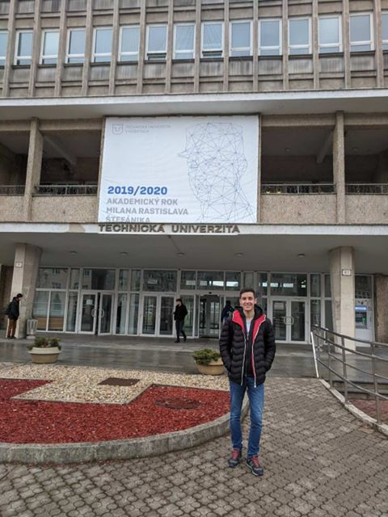
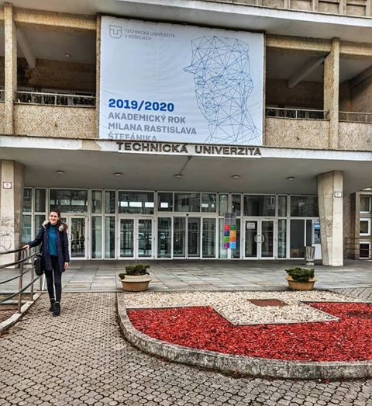
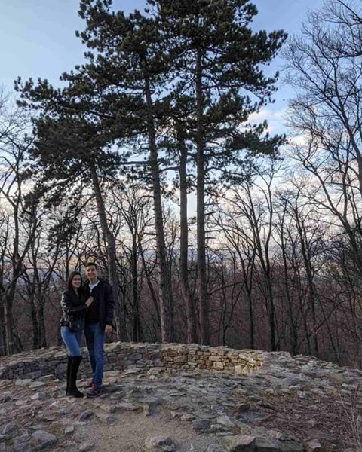
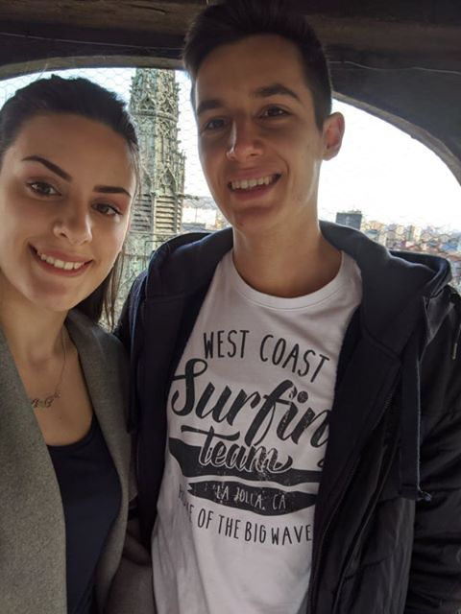
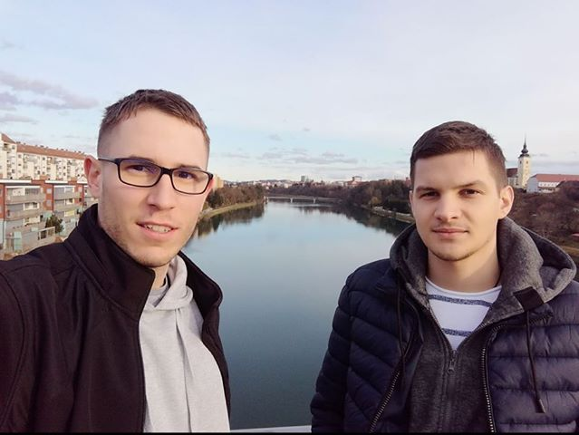
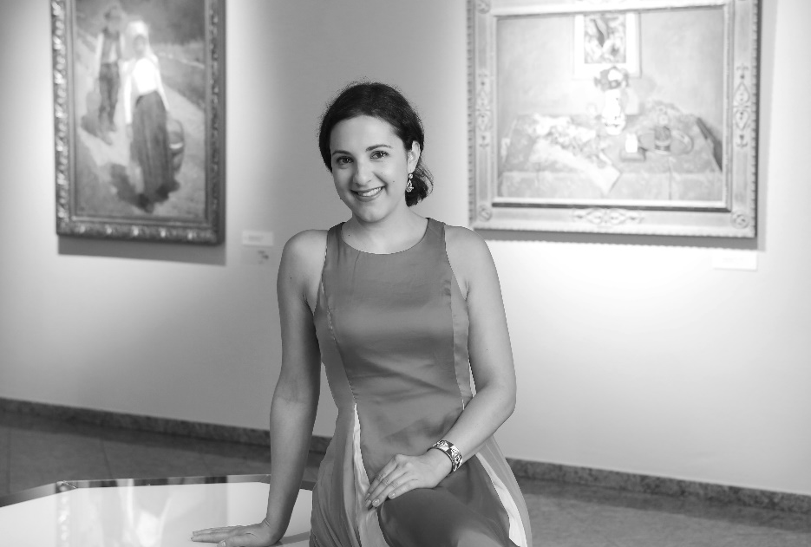
IS A GREAT OPPORTUNITY FOR YOU
Tatjana Ivošević
Luka Patarčić
David Gulači
Enikő Sőreg
Györe Noémi
Luka Mlinko

Slide 6
KEEP CALM AND BE PART OF
EVERYTHING YOU NEED
good study results
2 completed semesters
great knowledge of English
Professional development
Unforgettable experience
!

Slide 7
FURTHER INFORMATION
PERSONAL MEETING
International office:
Subotica Tech - College of Applied Sciences
Marka Oreskovica 16, office: 109
ONLINE
Email address:
mobility@vts.su.ac.rs

Slide 8
ADVENTURE, CAREER, COMMUNITY

